Slide 1
Web resources
Client API
Module 6
Notes:
http://crmbook.powerobjects.com/extending-crm/javascript/javascript-crm-model/#

Slide 2
Objectives
Best practices for writing Jscript libraries
Examine the Form and Control events, and the execution context
Invoking Jscript libraries from Form events
Using the Xrm API
Examine the form event handler execution context
Identify how to set event dependencies
Notes:
Use JScript Libraries from within CRM.
Determine when to use Business Rules or JavaScript
Explore form and field events.
Examine:
Xrm.Page object
Xrm.Page.context (client-side context object)
Xrm.Page.data.entity object
Xrm.Page.ui object

Slide 3
Starting With JavaScript
Un-typed interpreted language
Procedures all functions
Limited intellisense
var thisCouldBeAnything=“some string”;
function FirstFunction(p1,p2,p3){
thisCouldBeAnything=21;
return thisCouldBeAnything++;
}
Notes:
Like css, if there are repeated functions in scope with the same name, then the “last one wins”, so if several JavaScript libraries are added to a CRM form, and there is repetition of function names, previous functions are ignored. All JavaScript functions have an implicit arguments parameter passed to them, so even function NoDefinedParameters() can inspect the parameters passed by the implicit arguments parameter.
function NoDefinedParameters(){
if(arguments.length>0){
for(i=0;i<arguments.length;i++)
{
processData(arguments[i];
}
}
}

Slide 4
Starting With JavaScript
Use Visual Studio as editor
Use snippets (<script, if, for, ) – Tab Tab
function FirstFunction(){ return “I am the first function - overwritten”;}
function FirstFunction(){ return “I am the last first function - last in wins”;}
//call
alert(FirstFunction(“signatures ignored”));
//displays - “I am the last first function - last in wins”;
Notes:
Like css, if there are repeated functions in scope with the same name, then the “last one wins”, so if several JavaScript libraries are added to a CRM form, and there is repetition of function names, previous functions are ignored. All JavaScript functions have an implicit arguments parameter passed to them, so even function NoDefinedParameters() can inspect the parameters passed by the implicit arguments parameter.
function NoDefinedParameters(){
if(arguments.length>0){
for(i=0;i<arguments.length;i++)
{
processData(arguments[i];
}
}
}

Slide 5
JavaScript Naming conventions – good practice
Prefix organization name in front of logical names
  QA_validatePhoneNumber()
Use namespace style structures
Notes:
Ambiguous function names can be prevented by using a unique naming style, either with an organization prefix, or by using a namespace style containerisation. Creating JavaScript libraries, can benefit from using developing within a Visual Studio web application. First create an empty web application, add a Scripts folder and add new JavaScript files. Create functions, add an html page to the root of the site, drag the JavaScript file from the solution explorer into the <head> to create a <script src=“scripts/…”/>
Create an additional script tag below the first tag, and call the functions in the referenced JavaScript file.
//Scripts/QAUtils.cs
function QA_testone(){
alert(“don’t over use alerts as time consuming”);
console.log(“writing to the console window is useful as it can be viewed as an audit of what happened”);
}
//testpage.html
<script src=“scripts/QAUtils.cs”/>
<script>
QA_testone();
</script>

Slide 6
JavaScript Naming conventions – good practice
var QAUtils={};
QAUtils.ValidatePostcode=function(postcode){
var RegExpPattern = new RegExp(“ some pattern ”);
return RegExpPattern.test(postcode);
};
//call
var code=Xrm.Page.getAttribute(“address1_postalcode”).getValue();
if(!QAUtils.ValidatePostcode(code)){
alert(“invalid postcode”);
}
Notes:
Ambiguous function names can be prevented by using a unique naming style, either with an organization prefix, or by using a namespace style containerisation. Creating JavaScript libraries, can benefit from using developing within a Visual Studio web application. First create an empty web application, add a Scripts folder and add new JavaScript files. Create functions, add an html page to the root of the site, drag the JavaScript file from the solution explorer into the <head> to create a <script src=“scripts/…”/>
Create an additional script tag below the first tag, and call the functions in the referenced JavaScript file.
//Scripts/QAUtils.cs
function QA_testone(){
alert(“don’t over use alerts as time consuming”);
console.log(“writing to the console window is useful as it can be viewed as an audit of what happened”);
}
//testpage.html
<script src=“scripts/QAUtils.cs”/>
<script>
QA_testone();
</script>

Slide 7
Why Use Jscript Libraries
Client side scripts give real time feedback to user
Validate data entry, guide user on what to enter
Show/Hide components on forms
Change field requirement level
Format the data entered (dates and floats appropriately)
Access server side resources via Odata service calls, or from external systems to visualize related information
Call from form and form control events, ribbon, HTML web resources
Can support more complex validation than Business Rules
Can be exported and reused as part of a solution
Notes:
Forms in Customer Engagement help display data to the user. A form in Customer Engagement can contain items such as fields, a quick form, or a grid. An event occurs in Customer Engagement forms whenever:
A form loads
Data is changed in a field or an item within the form
Data is saved in a form
You can attach your JavaScript code to "react" to these events so that your code gets executed when the event occurs on the form. You attach your JavaScript code (scripts) to these events by using a Script web resource in Customer Engagement.

Slide 8
Why Use Business Rules
Simple to create through designer
Generates Client side scripts to give real time feedback to user
Validate data entry, guide user on what to enter
Show/Hide components on forms
Change field requirement level
Format the data entered (dates and floats appropriately)
Can be associated with one form or across all forms of an entity
Can be exported and reused as part of a solution
Notes:
Pros
Take simple validation tasks and show/hide tasks away from developers. Scope can be for form, all forms, or for the entity, so have a simple mechanism of defining validation logic that runs clientside or server side, which would be a complex task otherwise.
Cons
Limited in functions and logic mechanisms, and no reuse from other scripts
Business rules run only when the form loads and when field values change. They do not run when a record is saved, unless the scope for the rule is set at an entity level.
Business rules work only with fields. If you need to interact with other visible elements, such as tabs and sections, within the form you need use form scripts.
Whole Number fields that use the formats for TimeZone, Duration, or Language will not appear in the rule editor for the conditions or actions, so they cannot be used with business rules.
For Microsoft Dynamics CRM for tablets, the definition of the business rules are downloaded and cached when CRM for tablets opens. Changes made to business rules are not applied until CRM for tablets is closed and re-opened.
When you set the value of a lookup field, the text of the primary field value that is set in the form will always match the text that is visible in the rule definition. If the text representing the primary field value of the record you are setting in the lookup changes, the value set by your rule will continue to use the text portion of the primary field value defined by the rule. To fix this, update the rule definition to use the current primary name field value.

Slide 9
Priority of Client Side logic
Any system scripts are applied first
Any logic in custom form scripts is applied
Logic in business rules is applied
When there are multiple business rules, they are applied in the order they were activated, from oldest to newest
The Entity scope business rules are executed on the server, after the synchronous plug-ins
This means that to control the order in which business rules are applied, you must deactivate and reactivate the ones you want to be applied last
Notes:
Logic in business rules is applied in the order they were activated, from oldest to newest so in order to control the order deactivate and reactivate the ones you want to be applied last.
Localize error messages used in business rules
If you have more than one language provisioned for your organization, you will want to localize any error messages that you have set. Each time you set a message, a label is generated by the system. If you export the translations in your organization, you can add localized versions of your messages and then import those labels back into Microsoft Dynamics CRM, so that people using languages other than your base language can view the translated messages.
NOTE: If a field is validated by both JavaScript and a business rule, the validation by the Javascript (perhaps displaying a control.setNotification or clear notification will suppress the business rule.

Slide 10
Events to trigger JavaScript
OnLoad
  The OnLoad event occurs after the form has loaded
OnSave
  The OnSave event occurs when a user clicks the Save or Save and Close buttons or other actions that cause the form to be saved
OnChange
  The OnChange event is available on every field. And fires when the both the data in the field has changed and the field loses focus
TabStateChange
  This event occurs when a tab is expanded or collapsed
Notes:
OnLoad Event
The OnLoad event occurs after the form has loaded and so it cannot prevent the window from loading. The OnLoad event can be used to apply logic about how the form should be displayed, to set properties on fields (disable or hide), and interact with other page elements (perform calculations – although calculated fields can replace some of this functionality.
OnSave Event
The OnSave event occurs when a user clicks the Save or Save and Close buttons or other actions that cause the form to be saved, such as the Save method. The event always occurs, even when the data in the form has not changed. The OnSave event does not correspond to the standard HTML OnSubmit event.
A script can detect which action is performed to trigger the form save by using the getSaveMode method in the save event arguments retrieved from the getEventArgs method execution context.
The OnSave event can be canceled to prevent the data from being saved. This is important when AutoSave is enabled. So it is common to use as a trigger for form level validation or prevent saving if a field has already been validated as having a bad value.

Slide 11
Events to trigger JavaScript
OnReadyStateComplete
  The OnReadyStateComplete event indicates the content of the IFRAME has loaded and can be accessed in code
OnStageChange/Selected
  This event occurs when a stage of a business process flow control is selected
Notes:
The OnReadyStateComplete event indicates that the content of the IFRAME has loaded and can be accessed in code. Use this event when referencing IFRAME controls within your scripts.
The OnStageChange event occurs when the stage of a business process flow control changes. This event occurs when the user clicks the Next Stage or Move to previous stage buttons in the user interface or when a developer uses the formContext.data.process.moveNext or formContext.data.process.movePrevious methods. You can’t cancel the stage change using code in a handler for this event.
The OnStageSelected Event‎ This event occurs when a stage of a business process flow control is selected. You can’t cancel the stage selection using code in a handler for this event.

Slide 12
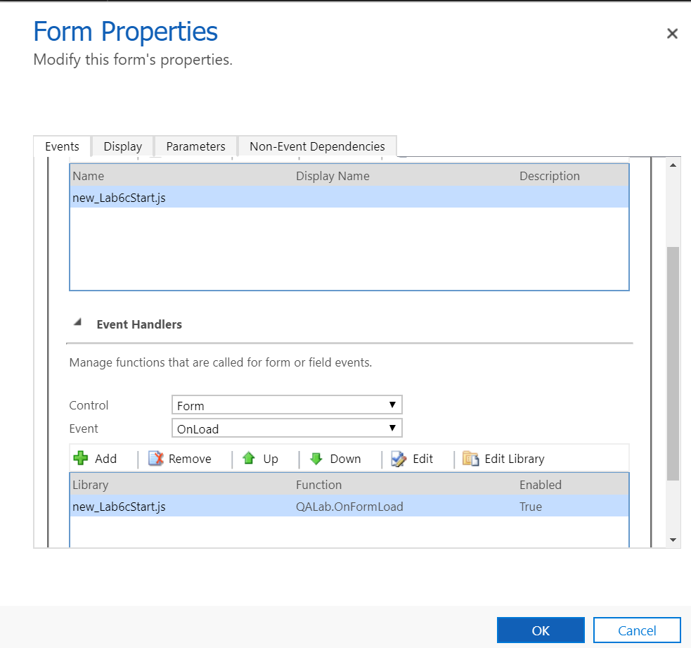
Add or remove event handler function
Notes:
Use the Event Handlers section of the Form Properties dialog box to associate your script with an event for forms and fields.

Slide 13
Demo – associate JavaScript with Event
Notes:
This Demo shows the creation of a script, to read the contact firstname and display it
Add the following script to a new JavaScript file Demo.js
function Greet(){
var firstname=formExecutionContext.getAttribute(“firstname”).getValue();
console.log( firstname + “ display in the debug environment console”);
alert(“Welcome ” + firstname);
}
Add the script as a web resource
Add the web resource as a library for the contact form
Add an eventhandler to the firstname change event to call the new Greet method of the referenced web resource.
Save and publish the customisations
Test the script by viewing a contact form and changing the firstname and tabbing out the field.
Press F12 in the browser window, change the firstname again and tab out and view the display in the console.

Slide 14
Lab Module 6 Lab A
Starting JavaScript and the Xrm object model

Slide 15
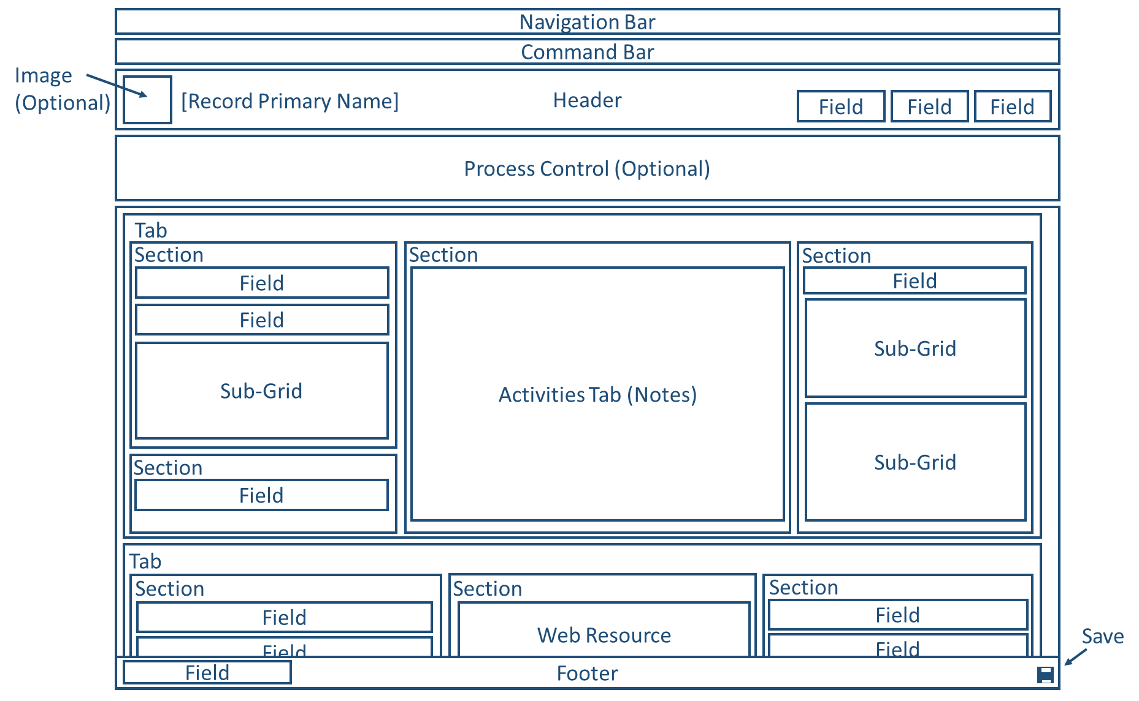
Components of a Form

Slide 16
Components of a Form Example code
function CollapseDetailsTab() {
formContext.ui.tabs.forEach(function (item,index) {
console.log(item)//SUMMARY_TAB, DETAILS_TAB
if (item.getName() == "DETAILS_TAB") {
item.setDisplayState("collapsed");
console.log("collapse details");
}
})
}

Slide 17
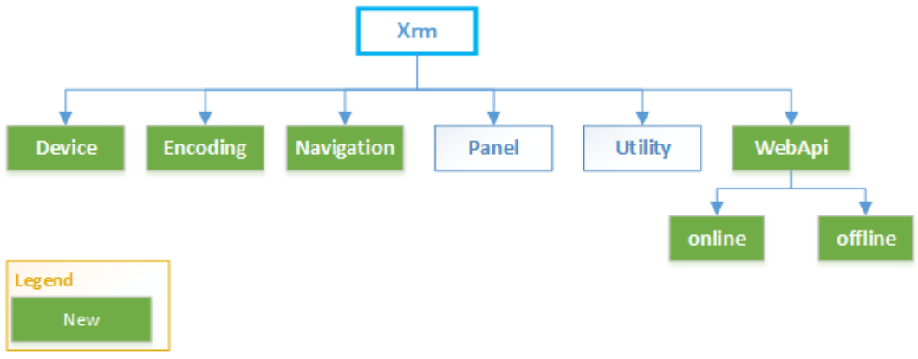
Object Model Xrm API
Notes:
The Xrm object is globally available to use in your code without having to use the execution context in Client API.
Xrm.Device Provides methods to use native device capabilities of mobile devices
Xrm.Encoding Provides methods to encode strings
Xrm.Navigation Provides methods for navigating forms and items in Customer Engagement
Xrm.Panel Provides a method to display a web page in the side pane of Customer Engagement form (currently a preview feature)
Xrm.Utility Provides a container for useful methods
Xrm.WebApi Provides methods to use Web API to create and manage records and execute Web API actions and functions. (will be covered in module 7)
Xrm.WebApi.offline Provides methods to create and manage records in the Dynamics 365 Customer Engagement mobile clients while working in the offline mode.

Slide 18
Xrm.Device
Provides methods to use native device capabilities of mobile devices
  captureAudio
  captureImage
  captureVideo
  getBarcodeValue
  getCurrentPosition
  pickFile
Notes:
captureAudio Invokes the device microphone to record audio.
captureImage Invokes the device camera to capture an image.
captureVideo Invokes the device camera to record video.
getBarcodeValue Invokes the device camera to scan the barcode information, such as a product number.
getCurrentPosition Returns the current location using the device geolocation capability.
pickFile Opens a dialog box to select files from your computer (web client) or mobile device (mobile clients).

Slide 19
Xrm.Encoding
Provides methods to encode and decode strings
  htmlAttributeEncode
  htmlDecode
  htmlEncode
  xmlAttributeEncode
  xmlEncode

Slide 20
Xrm.Utility
Provides a container for useful methods
  Including
    getGlobalContext
      getClientUrl
      getVersion
      isOnPremises
    getEntityMetadata
    showProgressIndicator
      Xrm.Utility.showProgressIndicator(message)
    closeProgressIndicator
      Xrm.Utility.closeProgressIndicator()

Slide 21
Xrm.Panel (Preview)
Provides a method to display a web page in the side pane of Customer Engagement form
  Xrm.Panel.loadPanel(url, title)
    This method is supported only for the web client

Slide 22
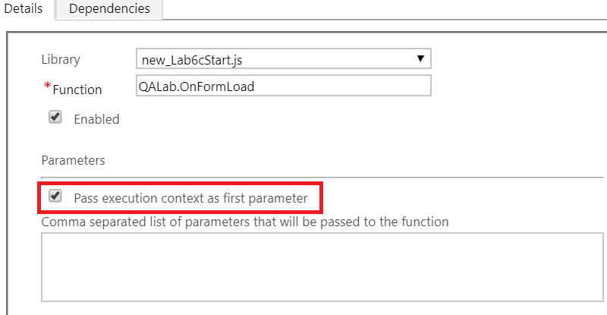
Xrm Execution context
The execution context defines the event context in which your code executes
The execution context is passed when an event occurs on a form or grid, which you can use it in your event handler to perform various tasks such as determine formContext or gridContext, or manage the save event.

Slide 23
Xrm Execution context
The execution context object provides the following methods
getDepth | Returns a value that indicates the order in which this handler is executed.
getEventArgs | Returns an object with methods to manage the OnSave event.
getEventSource | Returns a reference to the object that the event occurred on.
getFormContext | Returns a reference to the form or an item on the form depending on where the method was called.
getSharedVariable | Retrieves a variable set using the setSharedVariable method.
setSharedVariable | Sets the value of a variable to be used by a handler after the current handler completes.
Notes:
context.getIsAutoSaveEnabled()
https://msdn.microsoft.com/en-us/library/gg334511.aspx

Slide 24
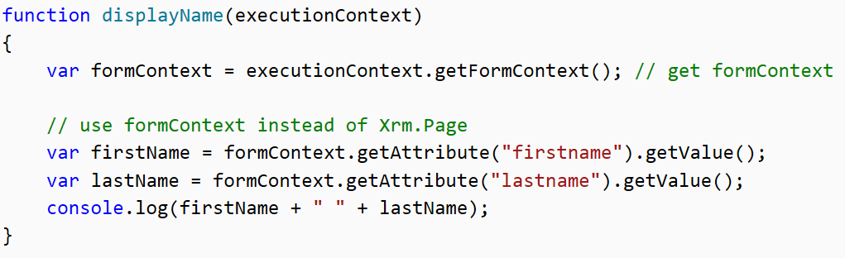
form context
The Client API form context
  reference to the form or to an item on the form
  Through the form context we access
    The Attributes of the entity (data)
    The Controls that render that data

Slide 25
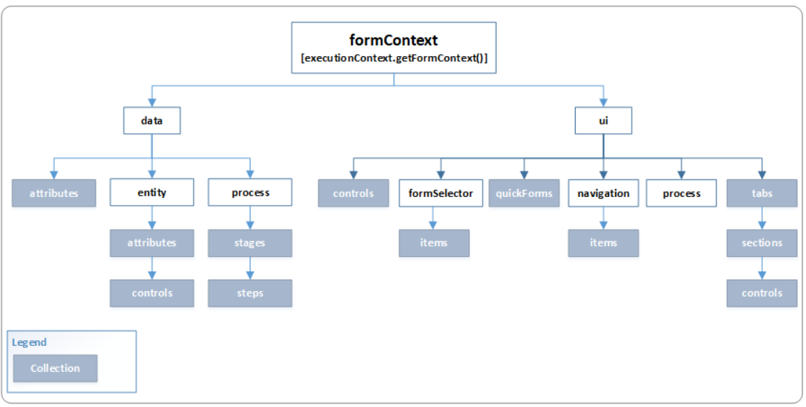
Notes:
Use the data and ui objects under the formContext object to programmatically manipulate data and user interface elements
data object
Provides access to the entity data and methods to manage the data in the form as well as in the business process flow control. Contains the following objects:
entity Provides methods to retrieve information specific to the record displayed on the page, the save method, and a collection of all the attributes included on the form.
process Provides methods to retrieve properties of a business process flow.

Slide 26
formContext.data Object
Object | Description
entity | Provides methods to retrieve information specific to the record displayed on the page, the save method, and a collection of all the attributes included on the form
process | Provides methods to retrieve properties of a business process flow.

Slide 27
formContext.ui Object
Object | Description
formSelector | Provides an items collection that provides capabilities to query the forms available for the current user. Use the navigate method to close the current form and open a different one.
navigation | Does not contain any methods. Provides access to navigation items through the items collection.
process | Provides methods to interact with the business process flow control on a form

Slide 28
formContext - Save and Refresh
Saving Data
  formContext.data.save(saveOptions).then(successCallback, errorCallback);
    Allows saving data asynchronously
  Allows callbacks for both success and errors. Allows callbacks when the save is done so you can do post processing
Refreshing Data
  formContext.data.refresh(true).then(successCallback, errorCallback);
  Refresh the data on the page – good for use after calling a service method via script
  Allows callbacks for both success and errors
Notes:
Multiple Forms – it is now common to have multiple forms for entities – script must be considered – is it specific to a single form or does it need to be registered for all forms – do different forms have some fields removed etc. – Business Rules can easily be registered to work across multiple forms or specific, Client Script must be setup on each new form and there is no way to register for all
Multiple Browser – most implication here is if you start doing scripting other than calling Xrm.Page which handles all the multiple browser issues – in that case you take ownership of supporting all browsers you want your solution to run on
Different Experiences – Dynamics 365 can be accessed through Web, Outlook, Tablet and Phone. Tablet for example runs most of the Xrm.Page script but does not support things like web resources. Developers can create custom applications now easily as well and those will not implement all the same scripting support – but would hit plugins for example
Business rules are a great example of configuration vs. code – it expands the audience that can help build and implement Dynamics 365 solutions often times freeing developers to do more hard core developer

Slide 29
formExecutionContext.data
Retrieve information specific to the record displayed on the page
Provides properties and methods to work with the data on a form
collection of all the attributes included in the form
Provides methods to retrieve properties of a business process flow
Notes:
Xrm.Page.data.entity.getDataXml()
//for an account with modified name, city
//returns<account><name>the new name</name><address1_city>the replacement city</ address1_city ></account>
function formload(){
Xrm.Page.data.entity.addOnSave(validateFunctionName);
}
function validateFunctionName(){
if(fieldvalue.length==0){
alert(“zero length is not exceptable”);
}
}

Slide 30
formContext.data.entity
getEntityName
getId
getIsDirty
OnSave
  addOnSave
  removeOnSave
getPrimaryAttributeValue
save
Notes:
https://docs.microsoft.com/en-us/dynamics365/customer-engagement/developer/clientapi/reference/formcontext-data-entity
Properties
attributes Collection of non-entity data on the form.
Items in this collection are of the same type as the attributes collection, but they are not attributes of the form entity.
More information: Collections
NOTE: This is supported only for Unified Interface clients. entity Provides methods to retrieve information specific to the record displayed on the page, the save method, and a collection of all the attributes included on the form. Attribute data is limited to attributes represented by fields on the form.
More information: formContext.data.entity process Provides objects and methods to interact with the business process flow data on a form.
More information: formContext.data.process

Slide 31
AddOnSave Example
function OnFormLoad(execContext)
{
var formConext = execContext.getFormContext();
formContext.data.entity.addOnSave(validateData)
}

Slide 32
formContext.data.entity.attributes
Provides methods to access the data for a record displayed on the form
To access an attribute within the collection, you pass either the name (string) or the index value (number) of the attribute as an argument to the method
  formContext.getAttribute(arg)
Notes:
formContext.data.entity.attributes

Slide 33
Many methods available to access attribute information
  formContext.getAttribute(arg).getInitialValue()
  formContext.getAttribute(arg).getValue()
  formContext. getAttribute(arg).getMaxLength()
Notes:
The slide shows some of the many methods available to access attribute information
var longway=Xrm.Page.data.entity.attributes.get(“address1_city”).getValue();
//Xrm shortcut
var shortcut = Xrm.Page.getAttribute(" address1_city ").getValue();
//user defined shortcut
var

Slide 34
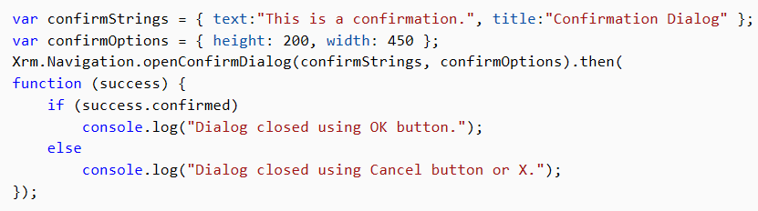
Xrm.Navigation – Confirms
Notes:
Displays a confirmation dialog box containing a message and two buttons

Slide 35
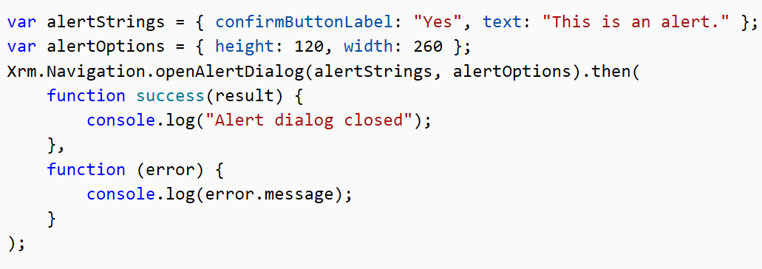
Xrm.Navigation – Alerts
Notes:
Displays an alert dialog containing a message and a button

Slide 36
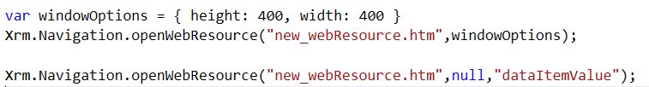
Xrm.Navigation.– openWebResource
Xrm.Navigation.openWebResource(webResourceName,windowOptions,data)
Notes:
An HTML web resource can accept the parameter values. This function only provides for passing in the optional data parameter.

Slide 37
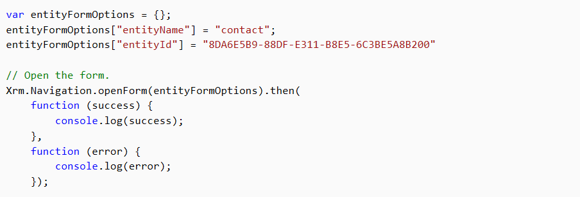
Xrm.Navigation.openForm
Xrm.Navigation.openForm(entityFormOptions,formParameters).then(successCallback,errorCallback)
Notes:
https://docs.microsoft.com/en-us/dynamics365/customer-engagement/developer/clientapi/reference/xrm-navigation/openform

Slide 38
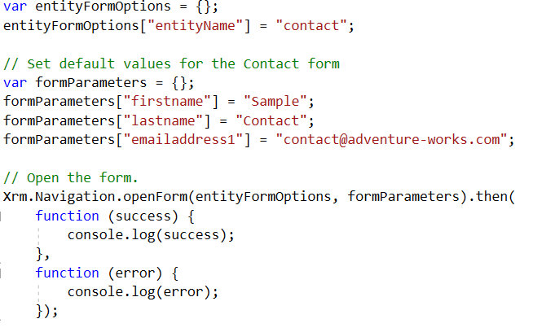
Xrm.Navigation.openForm (new form create)
Notes:
https://docs.microsoft.com/en-us/dynamics365/customer-engagement/developer/clientapi/reference/xrm-navigation/openform
The parameters to the openForm function allow you to specify for which entity type you wish to open the new form for and the values the for the entity attributes you wish to assign.

Slide 39
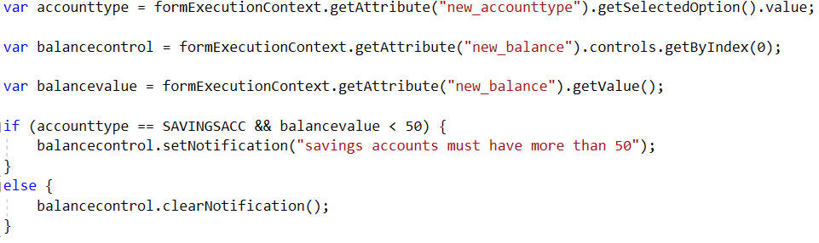
formContext.getControl(arg).addNotification(notification)
Notes:
Sets notiftcations on a control (display a warning message if validation fails) blocks a save operation unless cleared.

Slide 40
Lab Module 6 Lab B
Validation and control level notifiactions

Slide 41
formContext.ui.setFormNotification(message, level, uniqueId);
Form Level Notification
  formContext.ui.setFormNotification(message, level, uniqueId);
  formContext.ui.clearFormNotification(uniqueId)
  INFO, WARNING, ERROR
  Does not block save
Notes:
Use the form level notification to highlight information to the user but not block the save
Control level notification allows better context to the specific control that has invalid data. If validation is needed at a comparison between fields, then form level validation needed. Since this is non blocking of the Save process, and unless AutoSave is turned off, to prevent invalid data being automatically saved the change events for the invalid fields will need to set up some Boolean flag to show they are in error, and a onsave handler can detect the autosave, and prevent it if the invalid data flag is set.
Xrm.Page.ui.setFormNotification(message, level, uniqueId);
Xrm.Page.ui.clearFormNotification(uniqueid);
Xrm.Page.getControl(arg).setNotification(message,uniqueId)
Xrm.Page.getControl(arg).clearNotification(uniqueId)

Slide 42
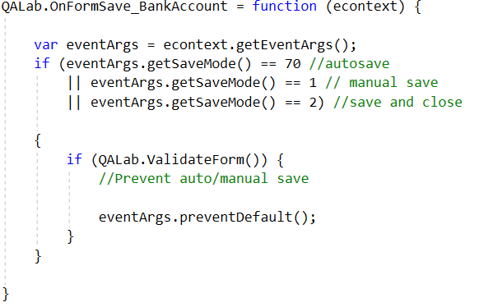
Turn off Auto Save
Notes:
Turning off autosave
This does not mean it is always a good idea to do this, this is just how to do it. Make sure to consider the best option when doing this, is disabling autosave the correct answer?

Slide 43
Module 6 Lab C
Validation and Form Notifications

Slide 44
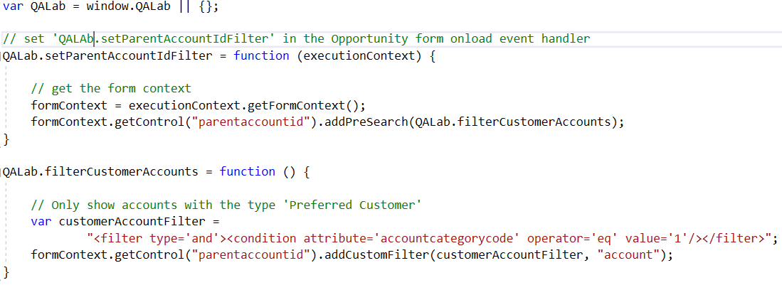
Filter Lookups
Notes:
Adds filters to the results displayed in the lookup. Each filter will be combined with any previously added filters as an “AND” condition.
The example code sample is for the Opportunity form Account (parentaccountid) lookup. When the Sdk.setParentAccountIdFilter function is set in the form Onload event handler, the QALab.filterCustomAccounts function is added to the PreSearch event for that lookup. Remember to select the option to pass in the execution context when setting the function in the form Onload event handler. The result is that only accounts with the Category (accountcategorycode) value of Preferred Customer (1) will be returned
// A namespace defined for SDK sample code
// You should define a unique namespace for your libraries
var QALab = window.QALab || {};
// set 'Sdk.setParentAccountIdFilter' in the Opportunity form onload event handler
QALab.setParentAccountIdFilter = function (executionContext) {
// get the form context
formContext = executionContext.getFormContext();
formContext.getControl("parentaccountid").addPreSearch(QALab.filterCustomerAccounts);
}
QALab.filterCustomerAccounts = function () {
// Only show accounts with the type 'Preferred Customer'
var customerAccountFilter = "<filter type='and'><condition attribute='accountcategorycode' operator='eq' value='1'/></filter>";
formContext.getControl("parentaccountid").addCustomFilter(customerAccountFilter, "account");
}

Slide 45
Execution Context and getEventSource
The execution context defines the event context in which your code execute
getEv entSource. Returns a reference to the object that the event occurred on
  Can be used to generate generic functions that are resuable
Notes:
This generic function can be used to bind the visibility of any section to the value of a boolean attribute. It requires the following:
1. It must only be added to the OnChange event of a Boolean attribute
2. When configuring the event handler, you must pass the execution context as the first parameter.
3. When configuring the event handler, you must specify the name of the section in the comma separated list of parameters that will be passed to the function. For example, if you want to hide the section with the name "marketing information", you must enter the following information in the field: "marketing information" (using quotation marks).
get/setSharedVariable allows the visibility of data through a dictionary collection between different procedures without the need to pass data from one procedure to another via parameters or return statements
getDepth provides a metric of the call stack in the current JavaScript context, how many procedures deep down from the original event handler.
getEventSource provides a pointer to the trigger of the current event, similar to the DOM window.event.srcElement
E.g.
QA.bindTabVisibilityToBooleanField = function (eContext, sectionName) {
Xrm.Page.ui.tabs.forEach(function (tab, index) {
tab.sections.forEach(function (section, index) {
if (section.getName() == sectionName)
{ section.setVisible(eContext.getEventSource().getValue()) }
});
});
};

Slide 46
Module 6 LAB D
Passing Execution Context

